Slide 1
Project 3:
TEXT CLASSIFICATION USING NATURAL LANGUAGE PROCESSING (NLP)
Samay Shah | General Assembly | 2021

Slide 2

Problem Statement
A marketing team for a food based startup company wants a model to easily classify their email inquiries from customers, plus get some insights on top keywords and topics that people online are actively discussing about and further craft their online content and improve on their SEO.

Slide 3
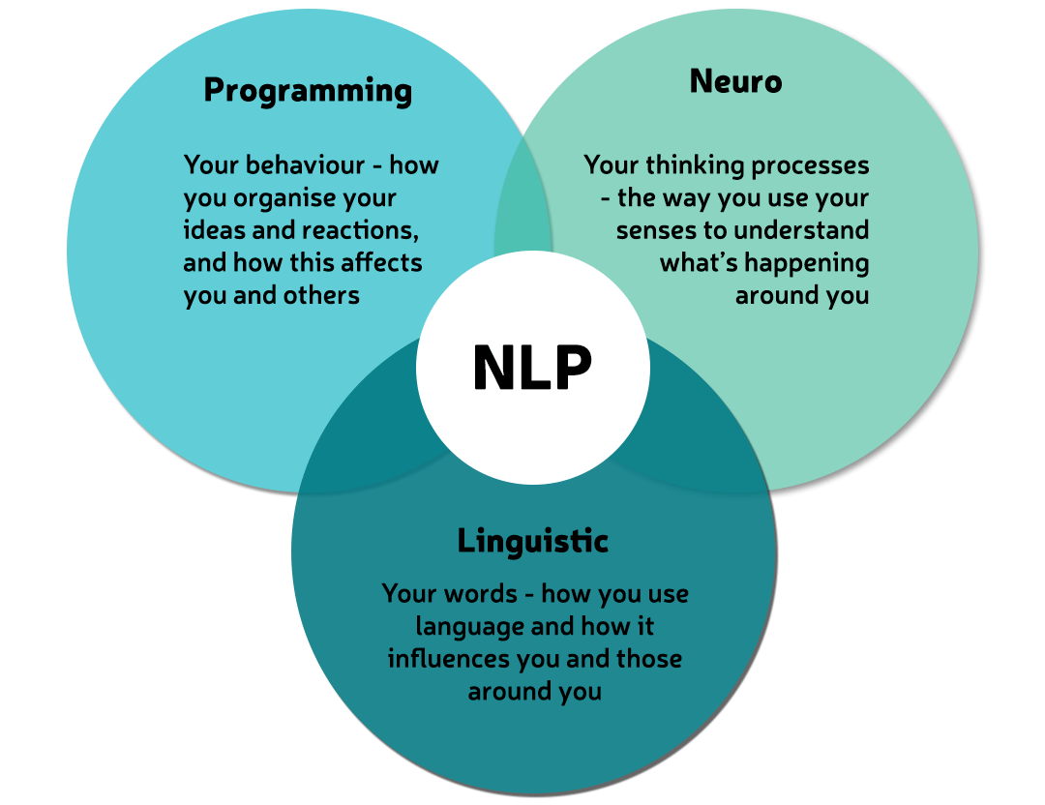
Executive Summary
What is NLP (Natural Language Processing)?
Uses of NLP – Email Filter, Predictive Text,
Language Translation, Smart Assistants (bots) etc.
Focus of this project: obtain data for Japanese Food, Chinese Food and Mexican Food, build a ML model to classify and gain insights
Image Reference

Slide 4
Contents
Import & Clean Data
EDA / Pre-process steps
Build Model-1 (classifier: Logistic Regression)
Build Model-2 (classifier: Random Forest) | Model-2 (Ada Boost) - Boosting
Build Model-3 (Naïve Bayes - Multinomial)
Build Model-4 (SVM – Support Vector Classifier)
Model Comparisons and selection
Recommendations for our marketing team
Scope of this project

Slide 5
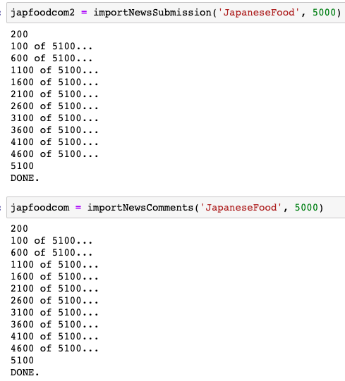
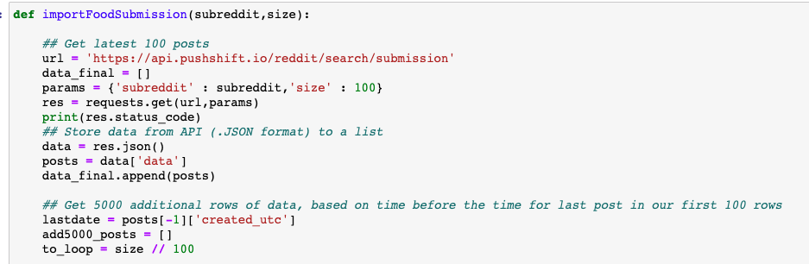
1. Data Cleaning
Import Data using Push Shift's API
No More Code, Promise!

Slide 6
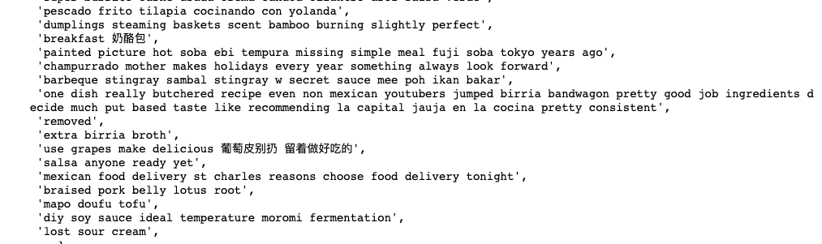
2. Pre process data
Preprocess content using NLP libraries like re, BeautifulSoup, NLTK and Sklearn.
Use concepts like Regular Expressions, Lemmetizing, Stemming, removing stopwords, manually using NLTK and Sklearn.
Highlight: Chinese Keywords needed a special RegExp! [\u4e00-\u9fff]
Reference for Chinese RegExp.

Slide 7
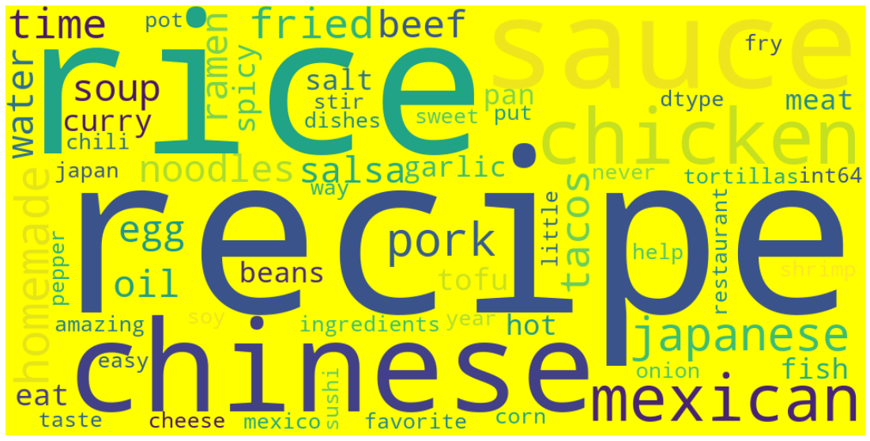
Reference for WordCloud

Slide 8
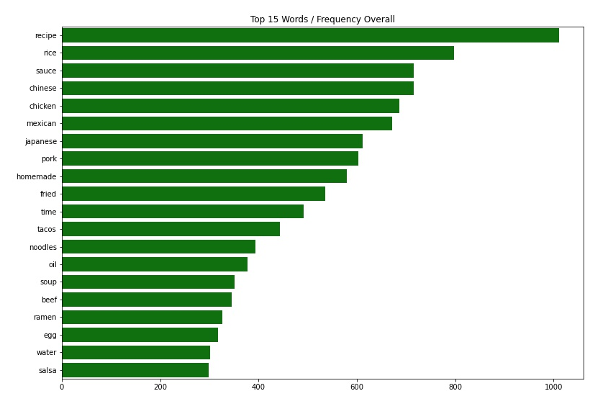
2. EDA
My top 5,
Recipe
Rice
Sauce
Chicken
Pork
Fun Insight: Recipes' and Homemade food tops the list!

Slide 9
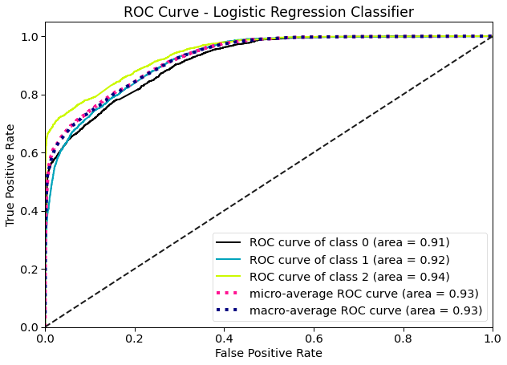
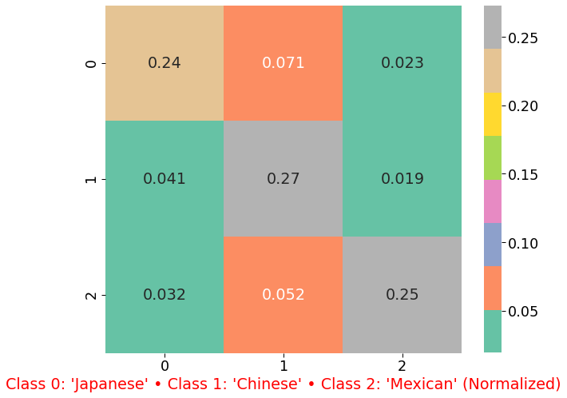
3. Model#1: Logistic Regression
Cross Val Score: 0.756
Train Accuracy: 0.803
Test Accuracy: 0.762
Area under ROC curve: 0.93
Verdict: Overfit!

Slide 10
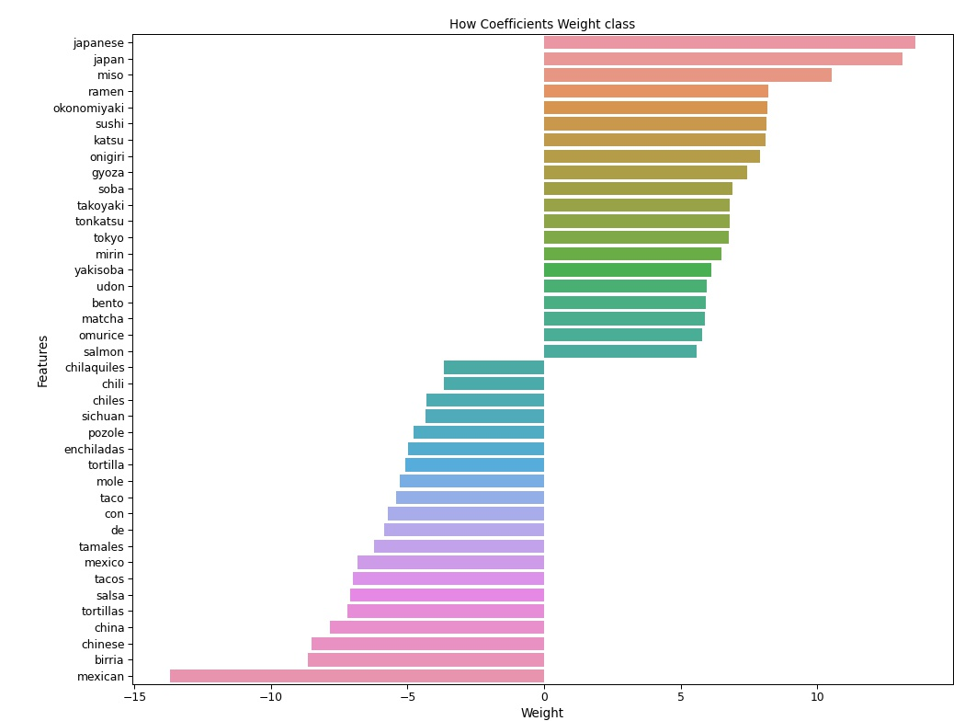
Ref
Based on top and bottom 20 words, we can see clear separation of classes by coefficient weights. These would be some of our top keywords to recommend for SEO optimization for Japanese and Mexican Cuisines. Chinese keywords blend with Japanese and hence fall some where in the middle.
Ref
Ref

Slide 11
4. Model#2: Random Forest
4. Model#2_2: Ada-Boost
Cross Val Score: 0.694
Train Accuracy: 0.719
Test Accuracy: 0.711
Area under ROC curve: 0.90
Verdict:
Consistent results, but less separated categories.
Cross Val Score: 0.615
Train Accuracy: 0.768
Test Accuracy: 0.735
Area under ROC curve: 0.85
Verdict: Overfit and even less separated categories. Punishes week learners, so less variance dropped.
Random Forest Vs
Ada Boost

Slide 12
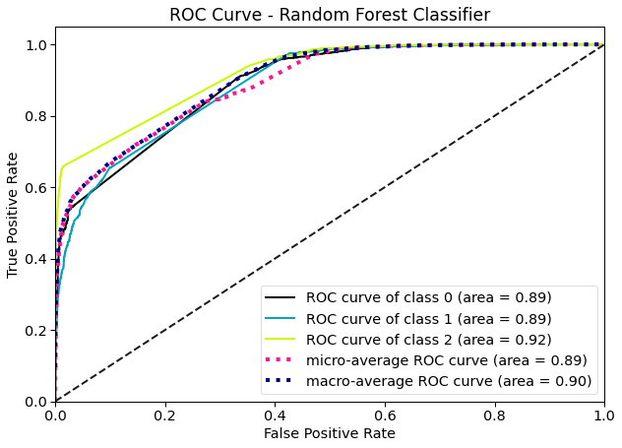
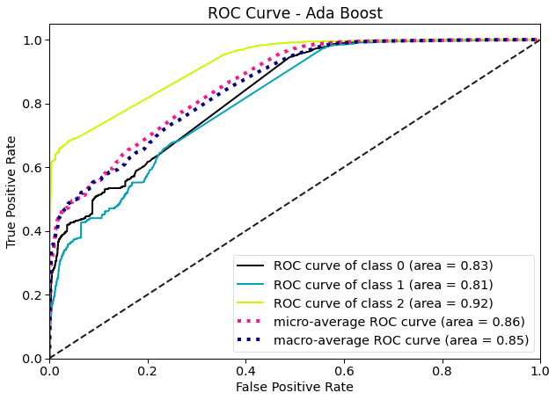
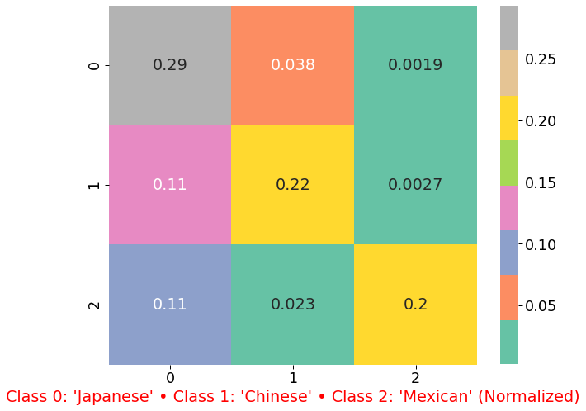
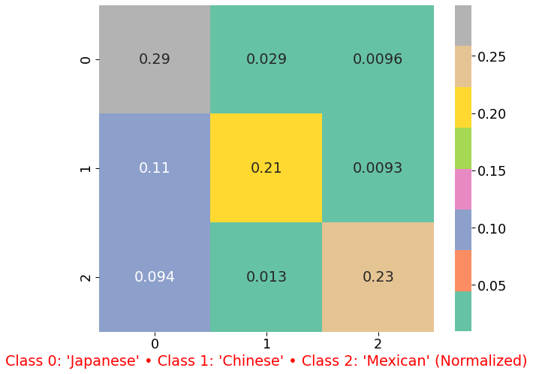

Random Forest Vs
Ada Boost

Slide 13
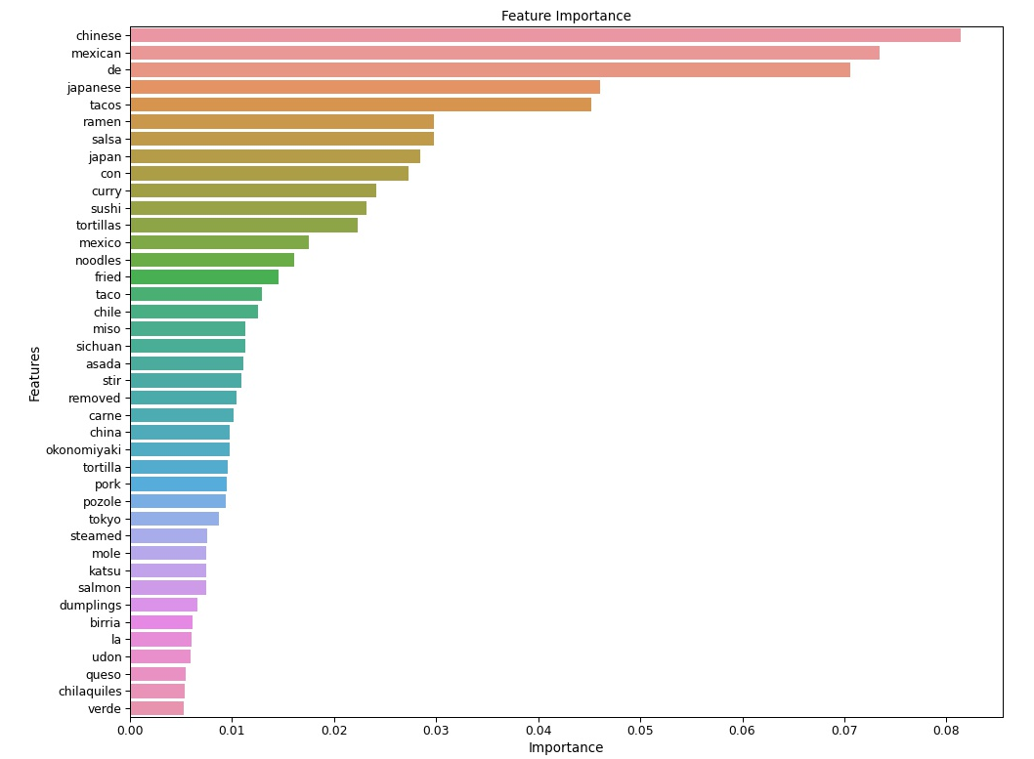
Top 40 Keywords for marketing team.

Slide 14
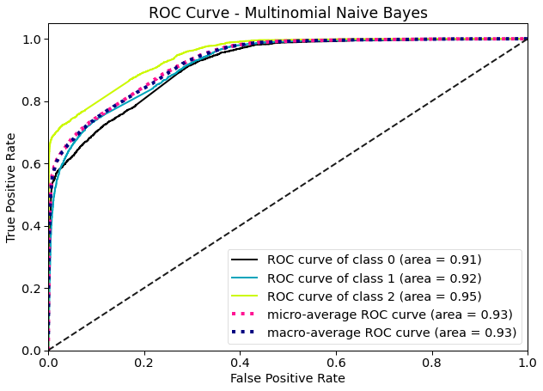
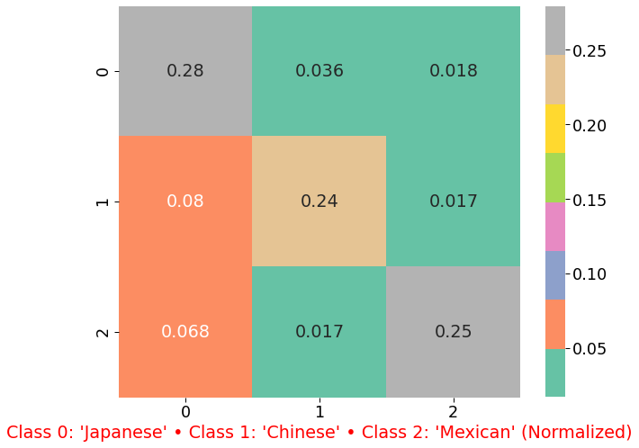
5. Model#3: Multinomial naïve bayes
Cross Val Score: 0.756
Train Accuracy: 0.782
Test Accuracy: 0.764
Area under ROC curve: 0.93
Verdict: Slightly high Variance, but more accurate compared to other models

Slide 15
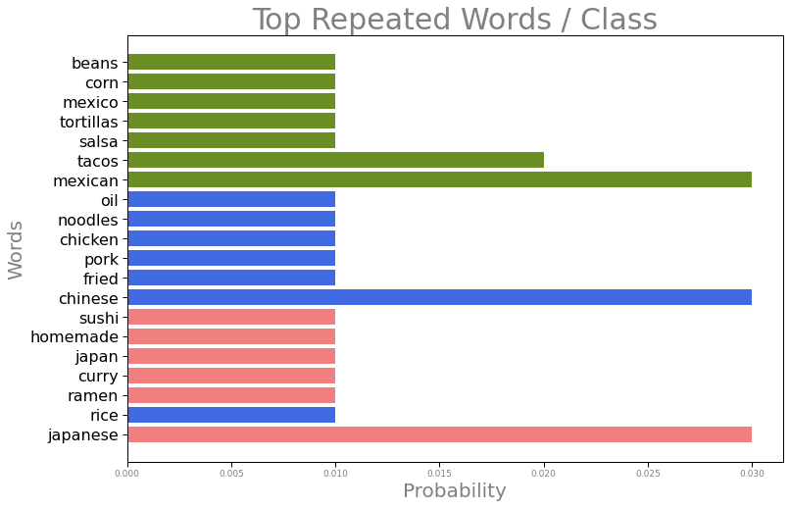

Slide 16
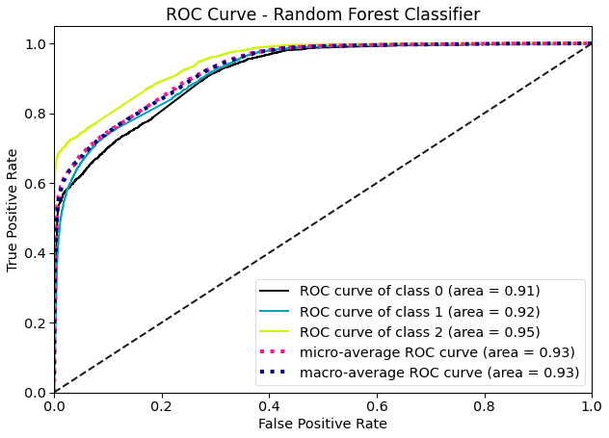

6. Model#4: SVM (Support Vector Classifier)
Cross Val Score: 0.701
Train Accuracy: 0.718
Test Accuracy: 0.703
Area under ROC curve: 0.93
Verdict: Consistent Accuracy and good separation of categories

Slide 17
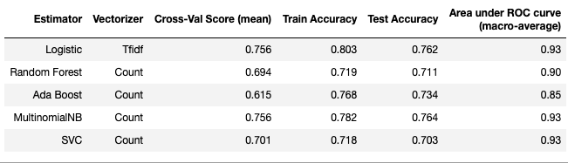
7. Model Comparison & selection
v
My Selection: Multinomial Naïve Bayes with Count Vectorizer.
Even though this model demonstrates a little overfitting but the results are more accurate. Based on my problem, Accuracy would be the most important metric as False Negative and False Positive imbalance does not create a huge impact in real life.

Slide 18
8. Insights
Ramen Vs. Noodle
Japanese: Rice, Ramen, Sushi
Chinese: Rice, Pork, Chicken and Noodles
Mexican: Taco, Chicken, Corn
My Recommendation:
Marketing team can use certain additional keywords like 'udon', 'okonomiyaki','katsu’ for Japanese, Chinese keywords like 'sinchuan’ and Mexican words like 'quesso', 'chiles', 'carne' on their online menu to increase their rankings.

Slide 19
9. Scope of this project
This model could further be expanded across more cuisines and diverse data can be collected from multiple platforms to increase models accuracy.

Slide 20

Questions
Run through the code and explore models as needed.
Thank you

